Slide 1
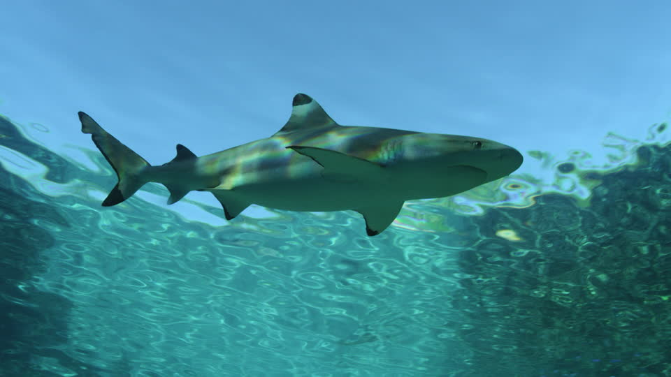
NPS/NAFL NORTH
5
ANIMALS THAT LIVE IN WATER
NPSNAFLNORTH|KOCL|May2021

Slide 2
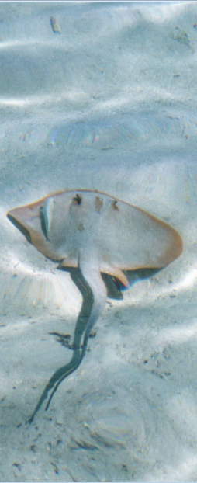
Contents
Vertebrates and Invertebrates Page 3
Invertebrates that Live in Water Page 4
Amphibians Page 11
Reptiles that Live in Water Page 13
Birds that Live Close to Water Page 15
The Blue Whale Page 17
Points to Remember Page 18
Vocabulary Page 19

Slide 3
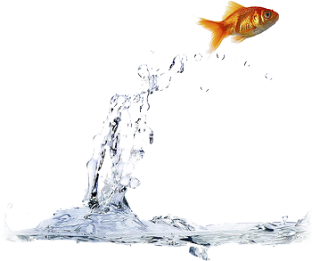
Vertebrates And Invertebrates
Animals can be divided into two groups - vertebrates and invertebrates.
Vertebrates are animals that have a skeleton made up of bones. Fish, amphibians, reptiles and mammals are vertebrates.
Invertebrates do not have a skeleton made up of bones. Insects, shellfish, coral, jellyfish and sponges are invertebrates.
Many kinds of vertebrate and invertebrate animals live in water. They are called aquatic animals.
Page | 3
Go back to the contents page

Slide 4
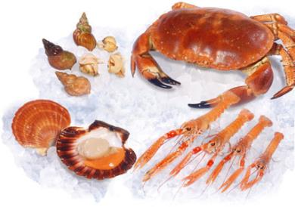
SHELLFISH
Invertebrates That live In Water
If you have visited a seashore, you may have collected a few seashells. The shell is a part of an animal that is commonly called a shellfish.
The hard shell protects the soft body of the shellfish. Shellfish do not have a bony skeleton. They are invertebrates.
There are different kinds of shellfish. Some shellfish also live in ponds, rivers and lakes. Most shellfish are small but a few that live in the sea are big. Most eat tiny aquatic living things.
Go back to the contents page
Page | 4

Slide 5
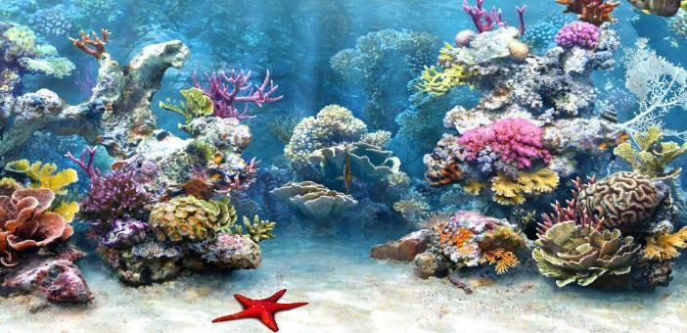
CORALS
Invertebrates That live In Water
These are sea animals. They have a soft body and a hard-shell covering. Corals feed on tiny living things. They look more like plants. There are many kinds of corals.
Corals are found in large numbers in the Andaman and Nicobar islands. Among them, the most spotted are brain coral, antler coral, finger coral and leather coral.
Go back to the contents page
Page | 5

Slide 6
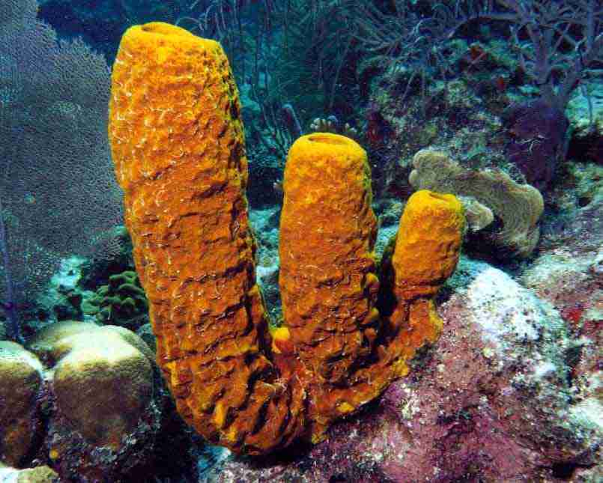
Invertebrates That live In Water
SPONGES
Sponges live only in the sea. They are animals with a soft body but do not have a hard covering like corals.
Sponges feed on tiny living things and their remains. They live in the same place all their life.
Go back to the contents page
Page | 6

Slide 7
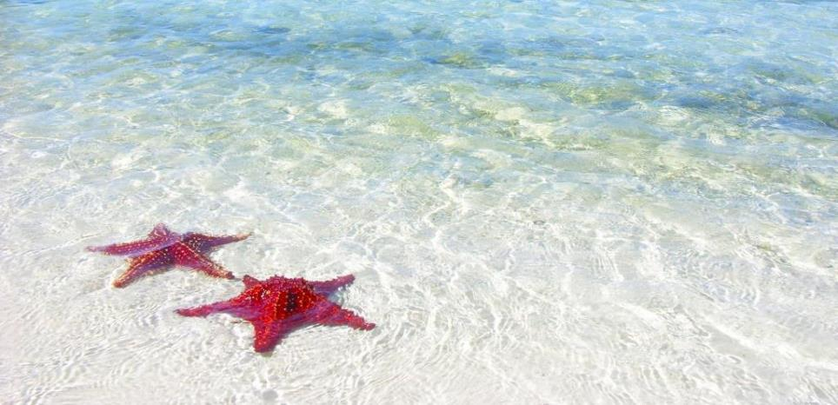
STARFISH
Invertebrates That live In Water
A starfish is not a fish. It has a spiny star-shaped body with five arms. There are many kinds of starfish. They live in the sea. They feed on shellfish, small fish, crabs and shrimps.
Go back to the contents page
Page | 7

Slide 8
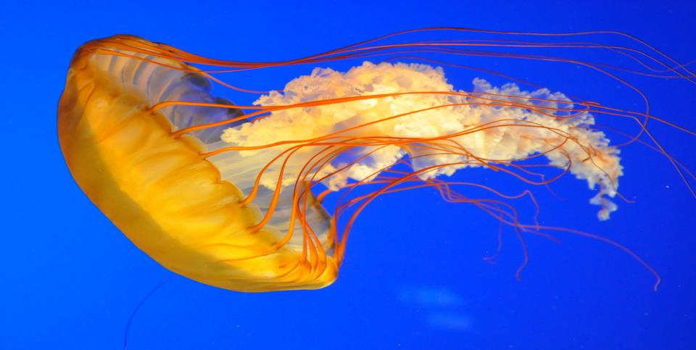
JELLYFISH
Invertebrates That live In Water
The jellyfish is a marine animal with an extremely soft body. It is not a fish. Jellyfish spend most of their time on the surface of the water and feed on tiny sea organisms.
Go back to the contents page
Page | 8

Slide 9
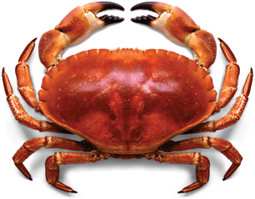
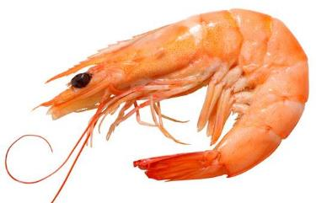
CRABS AND SHRIMPS
Invertebrates That live In Water
Crab
Many kinds of crabs and shrimps live in seas, lakes, rivers and ponds. They feed on smaller animals and the remains of dead animals and plants.
Some types of crabs live on land close to the water. Shrimps cannot live outside water.
Shellfish, corals, sponges, jellyfish, starfish, shrimps and crabs that live in water use oxygen that is dissolved in the water to breathe. All these animals lay eggs.
Shrimp
Go back to the contents page
Page | 9

Slide 10
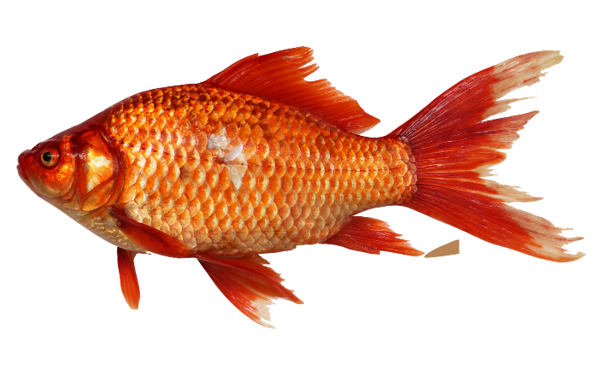
FISH
Vertebrates That live In Water
Fish live in the sea as well as in rivers, ponds and lakes. They have a skeleton made up of bones. Most fish have scales on their bodies. They swim with the help of their fins and breathe through their gills.
They lay eggs in water from which young ones hatch.
Go back to the contents page
Page | 10

Slide 11

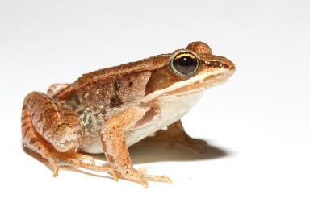
AMPHIBIANS
Amphibians
Animals that live on both land and water are called amphibians. Amphibians do not have hair, feathers, or scales.
Frogs and salamanders live in water or in wet places. They cannot live on dry land. Toads mostly live in dry places. You will often see toads at night below lamp posts, feeding on insects.
Amphibians breathe in air with the help of their lungs and
while in water they breathe through their skin.
Go back to the contents page
Page | 11

Slide 12
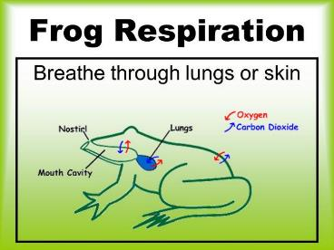
Amphibians
How is a frog able to live in water as well as on land?
We usually see frogs in the rainy season. Frogs mainly feed on insects like mosquitoes.
Frogs have special body features that enable them to live in water as well as on wet land close to water.
A Frog has moist skin through which it absorbs oxygen under water and has lungs to breathe on land. These two features help them adapt to living in water and on land. A tadpole lives in water. It obtains oxygen from the water with the help of its gills. A tadpole develops into a frog.
Go back to the contents page
Page | 12

Slide 13
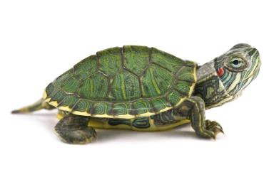
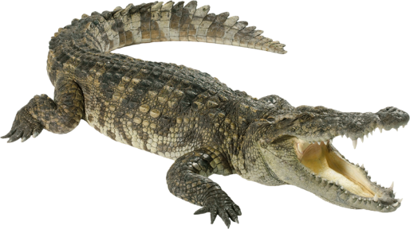
REPTILES THAT LIVE IN WATER
Reptiles That Live In Water
Reptiles are animals with a bony skeleton. A reptile has no hair or feathers. The body of a reptile is covered with scales. The scales found on reptiles are different from those found on a fish.
Sea snakes, turtles, crocodiles, garden lizards and iguanas are reptiles that live in water.
Go back to the contents page
Page | 13

Slide 14
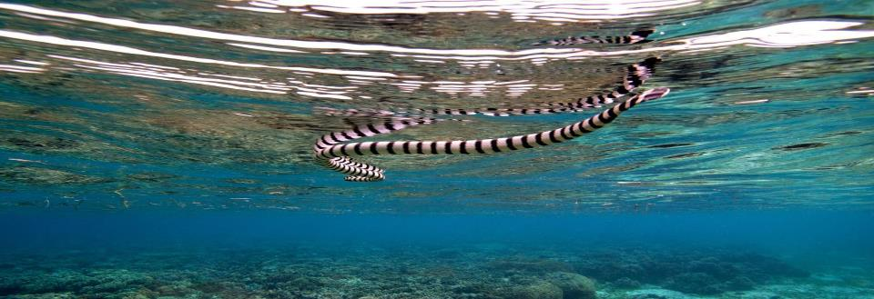
Reptiles That Live In Water
Sea Snake
All reptiles have well-developed lungs and breathe in air. Even turtles and sea snakes that live in water, do so.
Sea turtles and sea snakes live in the ocean. Some types of turtles live in ponds, lakes and rivers. The marine iguana lives on land and feeds on algae growing in the sea. Crocodiles live in rivers and lakes. Crocodiles, iguanas and turtles lay eggs on land. Most sea snakes do not lay eggs. They give birth to young ones.
Go back to the contents page
Page | 14

Slide 15
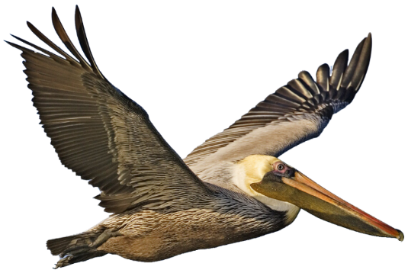
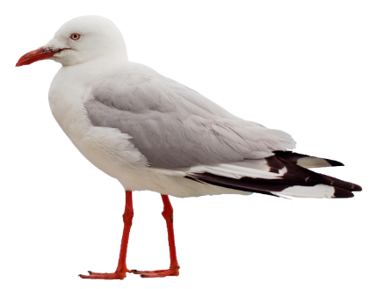
BIRDS THAT LIVE CLOSE TO WATER
Birds That Live Closer To Water
Most water birds live close to lakes, ponds, rivers, and wetlands. Wetlands are places covered with shallow water.
Penguins, pelicans, flamingoes, ducks, and seagulls are water birds. Their body structure and webbed feet make them excellent swimmers. All kinds of birds lay eggs.
Go back to the contents page
Page | 15

Slide 16
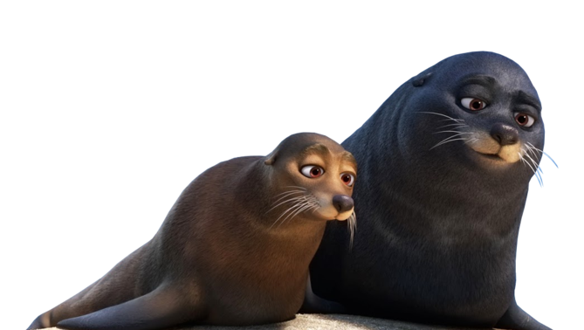
Mammals That Live In Water
Dolphins and whales are mammals that live in oceans.
Some dolphins live in rivers. Like all other mammals, they have lungs to breath. They give birth to young ones.
Seals and otters live in water most of the time. They can live on land too. Seals live in polar regions while otters can live in fresh water as well as sea water.
Go back to the contents page
Page | 16

Slide 17
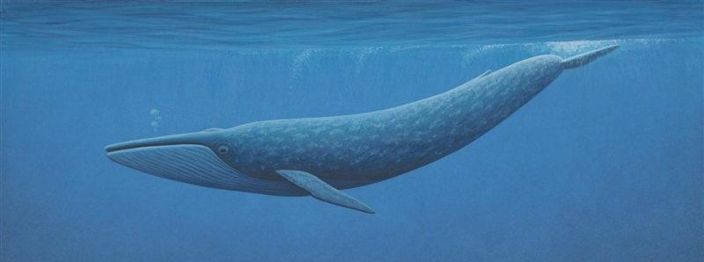
Houses
Blue Whale
Whales are very large. The blue whale is the largest animal living on Earth.
It feeds on tiny living things found in the ocean.
Go back to the contents page
Page | 17

Slide 18
Points To Remember
POINTS TO REMEMBER
No matter where we live, our actions affect the plants and animals that live in water. The wastewater from our homes, fields and industries finally ends up in rivers, lakes, streams, seas and oceans.
Here are some things you can do to protect the water bodies:
1
Do not throw paints, oils, or chemicals down the drain.
Minimize the use of chemical fertilizers, insecticides and pesticides for growing crops.
Turn kitchen waste into compost.
Do not throw flowers, food, plastic bags, idols or any waste into water bodies.
2
3
4
Go back to the contents page
Page | 18

Slide 19
Vocabulary
amphibians - animals that can live on land and water
aquatic animals - animals that live in water
invertebrates - animals that do not have a backbone
reptiles - a group of cold-blooded animals which have their skin covered with scales and reproduce by laying eggs
vertebrate - animals that have a skeleton made up of bones
Go back to the contents page
Page | 19

